Slide 1
Sorting Algorithms

Slide 2
Sorting
Sorting is a process that organizes a collection of data into either ascending or descending order.
An internal sort requires that the collection of data fit entirely in the computer’s main memory.
We can use an external sort when the collection of data cannot fit in the computer’s main memory all at once but must reside in secondary storage such as on a disk.
We will analyze only internal sorting algorithms.
Any significant amount of computer output is generally arranged in some sorted order so that it can be interpreted.
Sorting also has indirect uses. An initial sort of the data can significantly enhance the performance of an algorithm.
Majority of programming projects use a sort somewhere, and in many cases, the sorting cost determines the running time.
A comparison-based sorting algorithm makes ordering decisions only on the basis of comparisons.

Slide 3
Sorting Algorithms
There are many sorting algorithms, such as:
  Selection Sort
  Insertion Sort
  Bubble Sort
  Merge Sort
  Quick Sort
The first three are the foundations for faster and more efficient algorithms.

Slide 4
Selection Sort
The list is divided into two sublists, sorted and unsorted, which are divided by an imaginary wall.
We find the smallest element from the unsorted sublist and swap it with the element at the beginning of the unsorted data.
After each selection and swapping, the imaginary wall between the two sublists move one element ahead, increasing the number of sorted elements and decreasing the number of unsorted ones.
Each time we move one element from the unsorted sublist to the sorted sublist, we say that we have completed a sort pass.
A list of n elements requires n-1 passes to completely rearrange the data.

Slide 5
Sorted
Unsorted
23 | 78 | 45 | 8 | 32 | 56
8 | 78 | 45 | 23 | 32 | 56
8 | 23 | 45 | 78 | 32 | 56
8 | 23 | 32 | 78 | 45 | 56
8 | 23 | 32 | 45 | 78 | 56
8 | 23 | 32 | 45 | 56 | 78
Original List
After pass 1
After pass 2
After pass 3
After pass 4
After pass 5

Slide 6
Selection Sort (cont.)
template <class Item>
void selectionSort( Item a[], int n) {
for (int i = 0; i < n-1; i++) {
int min = i;
for (int j = i+1; j < n; j++)
if (a[j] < a[min]) min = j;
swap(a[i], a[min]);
}
}
template < class Object>
void swap( Object &lhs, Object &rhs )
{
Object tmp = lhs;
lhs = rhs;
rhs = tmp;
}

Slide 7
Selection Sort -- Analysis
In general, we compare keys and move items (or exchange items) in a sorting algorithm (which uses key comparisons).
➔ So, to analyze a sorting algorithm we should count the number of key comparisons and the number of moves.
    Ignoring other operations does not affect our final result.
In selectionSort function, the outer for loop executes n-1 times.
We invoke swap function once at each iteration.
➔ Total Swaps: n-1
➔ Total Moves: 3*(n-1) (Each swap has three moves)

Slide 8
Selection Sort – Analysis (cont.)
The inner for loop executes the size of the unsorted part minus 1 (from 1 to n-1), and in each iteration we make one key comparison.
➔ # of key comparisons = 1+2+...+n-1 = n*(n-1)/2
➔ So, Selection sort is O(n²)
The best case, the worst case, and the average case of the selection sort algorithm are same. ➔ all of them are O(n²)
  This means that the behavior of the selection sort algorithm does not depend on the initial organization of data.
  Since O(n²) grows so rapidly, the selection sort algorithm is appropriate only for small n.
  Although the selection sort algorithm requires O(n²) key comparisons, it only requires O(n) moves.
  A selection sort could be a good choice if data moves are costly but key comparisons are not costly (short keys, long records).

Slide 9
Comparison of N, logN and N²
N O(LogN) O(N²)
16 4 256
64 6 4K
256 8 64K
1,024 10 1M
16,384 14 256M
131,072 17 16G
262,144 18 6.87E+10
524,288 19 2.74E+11
1,048,576 20 1.09E+12
1,073,741,824 30 1.15E+18

Slide 10
Insertion Sort
Insertion sort is a simple sorting algorithm that is appropriate for small inputs.
  Most common sorting technique used by card players.
The list is divided into two parts: sorted and unsorted.
In each pass, the first element of the unsorted part is picked up, transferred to the sorted sublist, and inserted at the appropriate place.
A list of n elements will take at most n-1 passes to sort the data.

Slide 11
Sorted
Unsorted
23 | 78 | 45 | 8 | 32 | 56
23 | 78 | 45 | 8 | 32 | 56
23 | 45 | 78 | 8 | 32 | 56
8 | 23 | 45 | 78 | 32 | 56
8 | 23 | 32 | 45 | 78 | 56
8 | 23 | 32 | 45 | 56 | 78
Original List
After pass 1
After pass 2
After pass 3
After pass 4
After pass 5

Slide 12
Insertion Sort Algorithm
template <class Item>
void insertionSort(Item a[], int n)
{
for (int i = 1; i < n; i++)
{
Item tmp = a[i];
for (int j=i; j>0 && tmp < a[j-1]; j--)
a[j] = a[j-1];
a[j] = tmp;
}
}

Slide 13
Insertion Sort – Analysis
Running time depends on not only the size of the array but also the contents of the array.
Best-case: ➔ O(n)
  Array is already sorted in ascending order.
  Inner loop will not be executed.
  The number of moves: 2*(n-1) ➔ O(n)
  The number of key comparisons: (n-1) ➔ O(n)
Worst-case: ➔ O(n²)
  Array is in reverse order:
  Inner loop is executed i-1 times, for i = 2,3, …, n
  The number of moves: 2*(n-1)+(1+2+...+n-1)= 2*(n-1)+ n*(n-1)/2 ➔ O(n²)
  The number of key comparisons: (1+2+...+n-1)= n*(n-1)/2 ➔ O(n²)
Average-case: ➔ O(n²)
  We have to look at all possible initial data organizations.
So, Insertion Sort is O(n²)

Slide 14
Analysis of insertion sort
Which running time will be used to characterize this algorithm?
  Best, worst or average?
Worst:
  Longest running time (this is the upper limit for the algorithm)
  It is guaranteed that the algorithm will not be worse than this.
Sometimes we are interested in average case. But there are some problems with the average case.
  It is difficult to figure out the average case. i.e. what is average input?
  Are we going to assume all possible inputs are equally likely?
  In fact for most algorithms average case is same as the worst case.

Slide 15
Bubble Sort
The list is divided into two sublists: sorted and unsorted.
The smallest element is bubbled from the unsorted list and moved to the sorted sublist.
After that, the wall moves one element ahead, increasing the number of sorted elements and decreasing the number of unsorted ones.
Each time an element moves from the unsorted part to the sorted part one sort pass is completed.
Given a list of n elements, bubble sort requires up to n-1 passes to sort the data.

Slide 16
Bubble Sort
23 | 78 | 45 | 8 | 32 | 56
8 | 23 | 78 | 45 | 32 | 56
8 | 23 | 32 | 78 | 45 | 56
8 | 23 | 32 | 45 | 78 | 56
8 | 23 | 32 | 45 | 56 | 78
Original List
After pass 1
After pass 2
After pass 3
After pass 4

Slide 17
Bubble Sort Algorithm
template <class Item>
void bubleSort(Item a[], int n)
{
bool sorted = false;
int last = n-1;
for (int i = 0; (i < last) && !sorted; i++){
sorted = true;
for (int j=last; j > i; j--)
if (a[j-1] > a[j]{
swap(a[j],a[j-1]);
sorted = false; // signal exchange
}
}
}

Slide 18
Bubble Sort – Analysis
Best-case: ➔ O(n)
  Array is already sorted in ascending order.
  The number of moves: 0 ➔ O(1)
  The number of key comparisons: (n-1) ➔ O(n)
Worst-case: ➔ O(n²)
  Array is in reverse order:
  Outer loop is executed n-1 times,
  The number of moves: 3*(1+2+...+n-1) = 3 * n*(n-1)/2 ➔ O(n²)
  The number of key comparisons: (1+2+...+n-1)= n*(n-1)/2 ➔ O(n²)
Average-case: ➔ O(n²)
  We have to look at all possible initial data organizations.
So, Bubble Sort is O(n²)

Slide 19
Mergesort
Mergesort algorithm is one of two important divide-and-conquer sorting algorithms (the other one is quicksort).
It is a recursive algorithm.
  Divides the list into halves,
  Sort each halve separately, and
  Then merge the sorted halves into one sorted array.

Slide 20
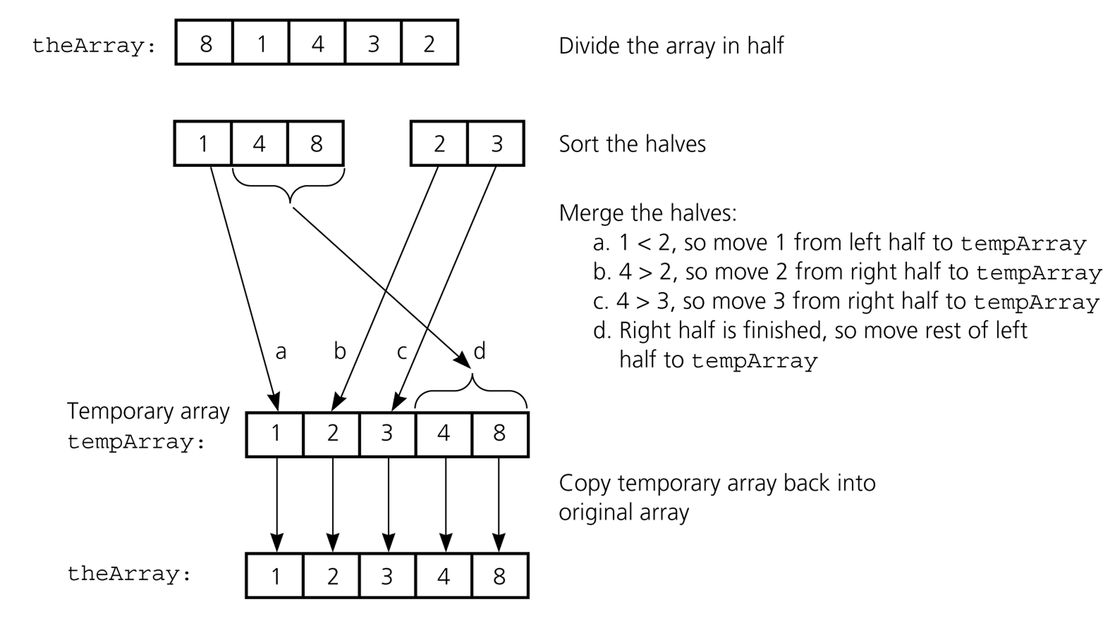
Mergesort - Example

Slide 21
Merge
const int MAX_SIZE = maximum-number-of-items-in-array;
void merge(DataType theArray[], int first, int mid, int last) {
DataType tempArray[MAX_SIZE]; // temporary array
int first1 = first; // beginning of first subarray
int last1 = mid; // end of first subarray
int first2 = mid + 1; // beginning of second subarray
int last2 = last; // end of second subarray
int index = first1; // next available location in tempArray
for ( ; (first1 <= last1) && (first2 <= last2); ++index) {
if (theArray[first1] < theArray[first2]) {
tempArray[index] = theArray[first1];
++first1;
}
else {
tempArray[index] = theArray[first2];
++first2;
} }

Slide 22
Merge (cont.)
// finish off the first subarray, if necessary
for (; first1 <= last1; ++first1, ++index)
tempArray[index] = theArray[first1];
// finish off the second subarray, if necessary
for (; first2 <= last2; ++first2, ++index)
tempArray[index] = theArray[first2];
// copy the result back into the original array
for (index = first; index <= last; ++index)
theArray[index] = tempArray[index];
} // end merge

Slide 23
Mergesort
void mergesort(DataType theArray[], int first, int last) {
if (first < last) {
int mid = (first + last)/2; // index of midpoint
mergesort(theArray, first, mid);
mergesort(theArray, mid+1, last);
// merge the two halves
merge(theArray, first, mid, last);
}
} // end mergesort

Slide 24
Mergesort - Example
6 | 3 | 9 | 1 | 5 | 4 | 7 | 2
divide
6 | 3 | 9 | 1
5 | 4 | 7 | 2
divide
divide
6 | 3
9 | 1
5 | 4
7 | 2
divide
divide
divide
divide
6
3
9
1
5
4
7
2
merge
merge
merge
merge
3 | 6
1 | 9
4 | 5
2 | 7
merge
merge
1 | 3 | 6 | 9
2 | 4 | 5 | 7
merge
1 | 2 | 3 | 4 | 5 | 7 | 8 | 9

Slide 25
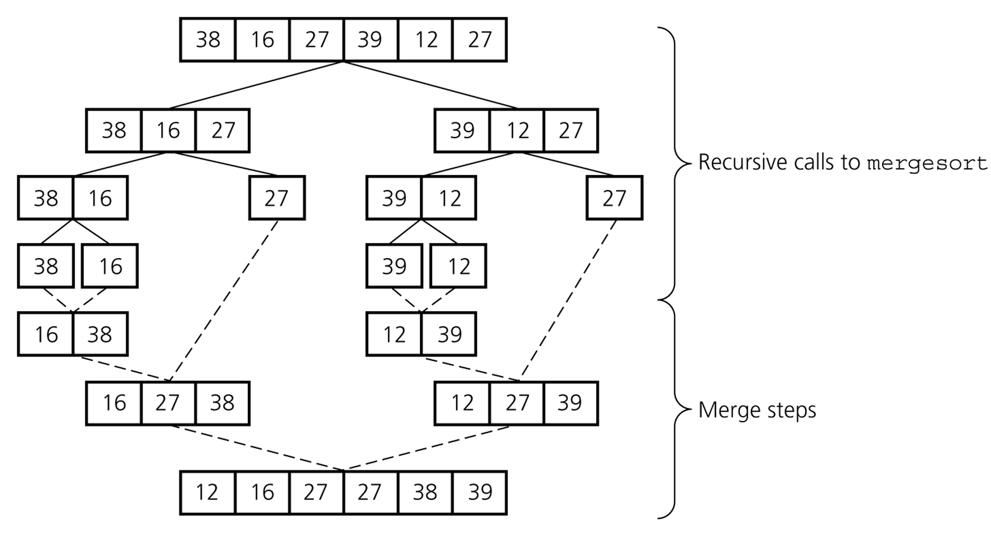
Mergesort – Example2

Slide 26
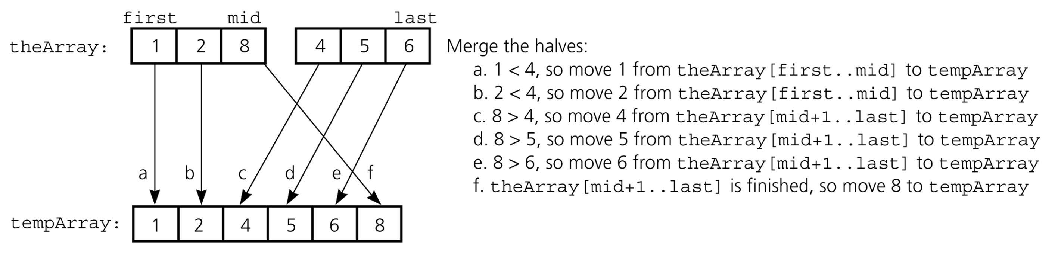
Mergesort – Analysis of Merge
A worst-case instance of the merge step in mergesort

Slide 27
Mergesort – Analysis of Merge (cont.)
0 k-1
0 k-1
Merging two sorted arrays of size k
Best-case:
  All the elements in the first array are smaller (or larger) than all the elements in the second array.
  The number of moves: 2k + 2k
  The number of key comparisons: k
Worst-case:
  The number of moves: 2k + 2k
  The number of key comparisons: 2k-1
 | ......
 | ......
0 2k-1
 | ......

Slide 28
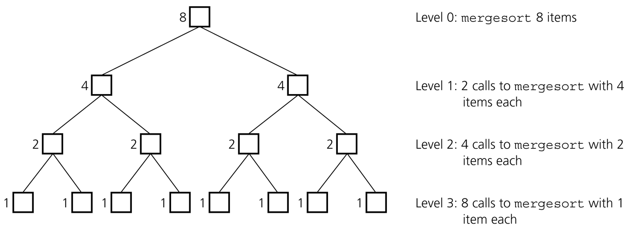
Mergesort - Analysis
Levels of recursive calls to mergesort, given an array of eight items

Slide 29
Mergesort - Analysis
2^{m}
level 0 : 1 merge (size 2^{m-1})
2^{m-1}
2^{m-1}
level 1 : 2 merges (size 2^{m-2})
level 2 : 4 merges (size 2^{m-3})
2^{m-2}
2^{m-2}
2^{m-2}
2^{m-2}
.
.
.
.
.
.
level m-1 : 2^{m-1} merges (size 2⁰)
2⁰
2⁰
. . . . . . . . . . . . . . . . .
level m

Slide 30
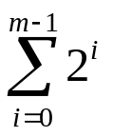
Mergesort - Analysis
Worst-case –
The number of key comparisons:
= 2⁰*(2*2^{m-1}-1) + 2¹*(2*2^{m-2}-1) + ... + 2^{m-1}*(2*2⁰-1)
= (2^{m} - 1) + (2^{m} - 2) + ... + (2^{m} – 2^{m-1}) ( m terms )
= m*2^{m} –
= m*2^{m} – 2^{m} – 1
Using m = log n
= n * log₂n – n – 1
➔ O (n * log₂n )

Slide 31
Mergesort – Analysis
Mergesort is extremely efficient algorithm with respect to time.
  Both worst case and average cases are O (n * log₂n )
But, mergesort requires an extra array whose size equals to the size of the original array.
If we use a linked list, we do not need an extra array
  But, we need space for the links
  And, it will be difficult to divide the list into half ( O(n) )

Slide 32
Quicksort
Like mergesort, Quicksort is also based on
the divide-and-conquer paradigm.
But it uses this technique in a somewhat opposite manner,
as all the hard work is done before the recursive calls.
It works as follows:
  First, it partitions an array into two parts,
  Then, it sorts the parts independently,
  Finally, it combines the sorted subsequences by
  a simple concatenation.

Slide 33
Quicksort (cont.)
The quick-sort algorithm consists of the following three steps:
1. Divide: Partition the list.
  To partition the list, we first choose some element from the list for which we hope about half the elements will come before and half after. Call this element the pivot.
  Then we partition the elements so that all those with values less than the pivot come in one sublist and all those with greater values come in another.
2. Recursion: Recursively sort the sublists separately.
3. Conquer: Put the sorted sublists together.

Slide 34
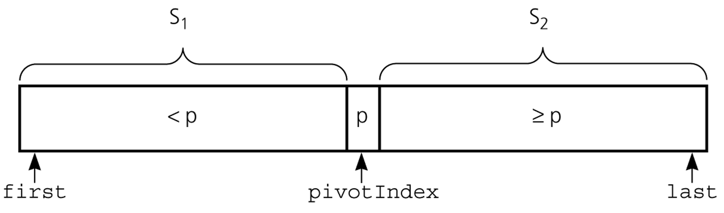
Partition
Partitioning places the pivot in its correct place position within the array.
Arranging the array elements around the pivot p generates two smaller sorting problems.
  sort the left section of the array, and sort the right section of the array.
  when these two smaller sorting problems are solved recursively, our bigger sorting problem is solved.

Slide 35
Partition – Choosing the pivot
First, we have to select a pivot element among the elements of the given array, and we put this pivot into the first location of the array before partitioning.
Which array item should be selected as pivot?
  Somehow we have to select a pivot, and we hope that we will get a good partitioning.
  If the items in the array arranged randomly, we choose a pivot randomly.
  We can choose the first or last element as a pivot (it may not give a good partitioning).
  We can use different techniques to select the pivot.

Slide 36
Partition Function
template <class DataType>
void partition(DataType theArray[], int first, int last,
int &pivotIndex) {
// Partitions an array for quicksort.
// Precondition: first <= last.
// Postcondition: Partitions theArray[first..last] such that:
// S1 = theArray[first..pivotIndex-1] < pivot
// theArray[pivotIndex] == pivot
// S2 = theArray[pivotIndex+1..last] >= pivot
// Calls: choosePivot and swap.
// place pivot in theArray[first]
choosePivot(theArray, first, last);
DataType pivot = theArray[first]; // copy pivot

Slide 37
Partition Function (cont.)
// initially, everything but pivot is in unknown
int lastS1 = first; // index of last item in S1
int firstUnknown = first + 1; //index of 1st item in unknown
// move one item at a time until unknown region is empty
for (; firstUnknown <= last; ++firstUnknown) {
// Invariant: theArray[first+1..lastS1] < pivot
// theArray[lastS1+1..firstUnknown-1] >= pivot
// move item from unknown to proper region
if (theArray[firstUnknown] < pivot) { // belongs to S1
++lastS1;
swap(theArray[firstUnknown], theArray[lastS1]);
} // else belongs to S2
}
// place pivot in proper position and mark its location
swap(theArray[first], theArray[lastS1]);
pivotIndex = lastS1;
} // end partition

Slide 38
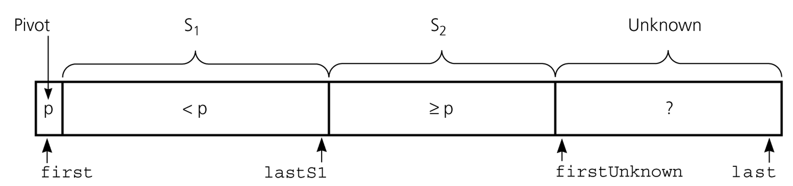
Partition Function (cont.)
Invariant for the partition algorithm

Slide 39
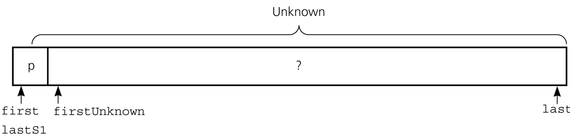
Partition Function (cont.)
Initial state of the array

Slide 40
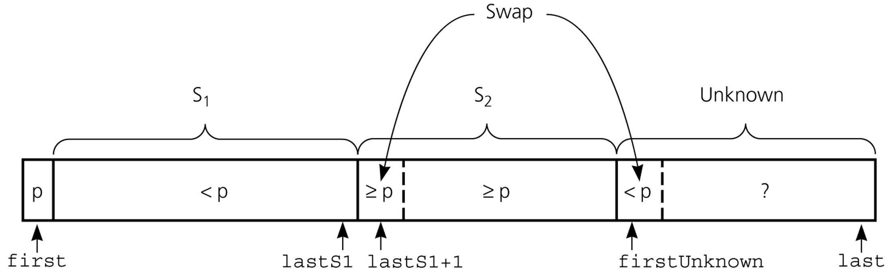
Partition Function (cont.)
Moving theArray[firstUnknown] into S₁ by swapping it with
theArray[lastS1+1] and by incrementing both lastS1 and firstUnknown.

Slide 41
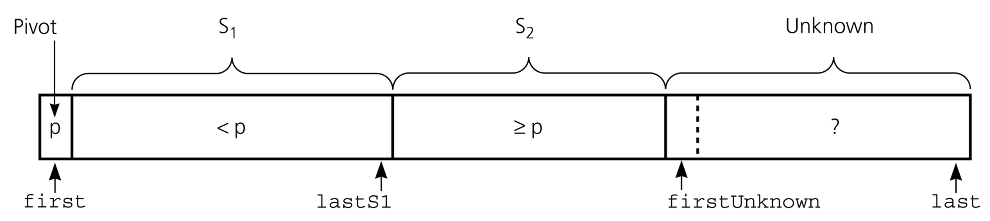
Partition Function (cont.)
Moving theArray[firstUnknown] into S₂ by incrementing firstUnknown.

Slide 42
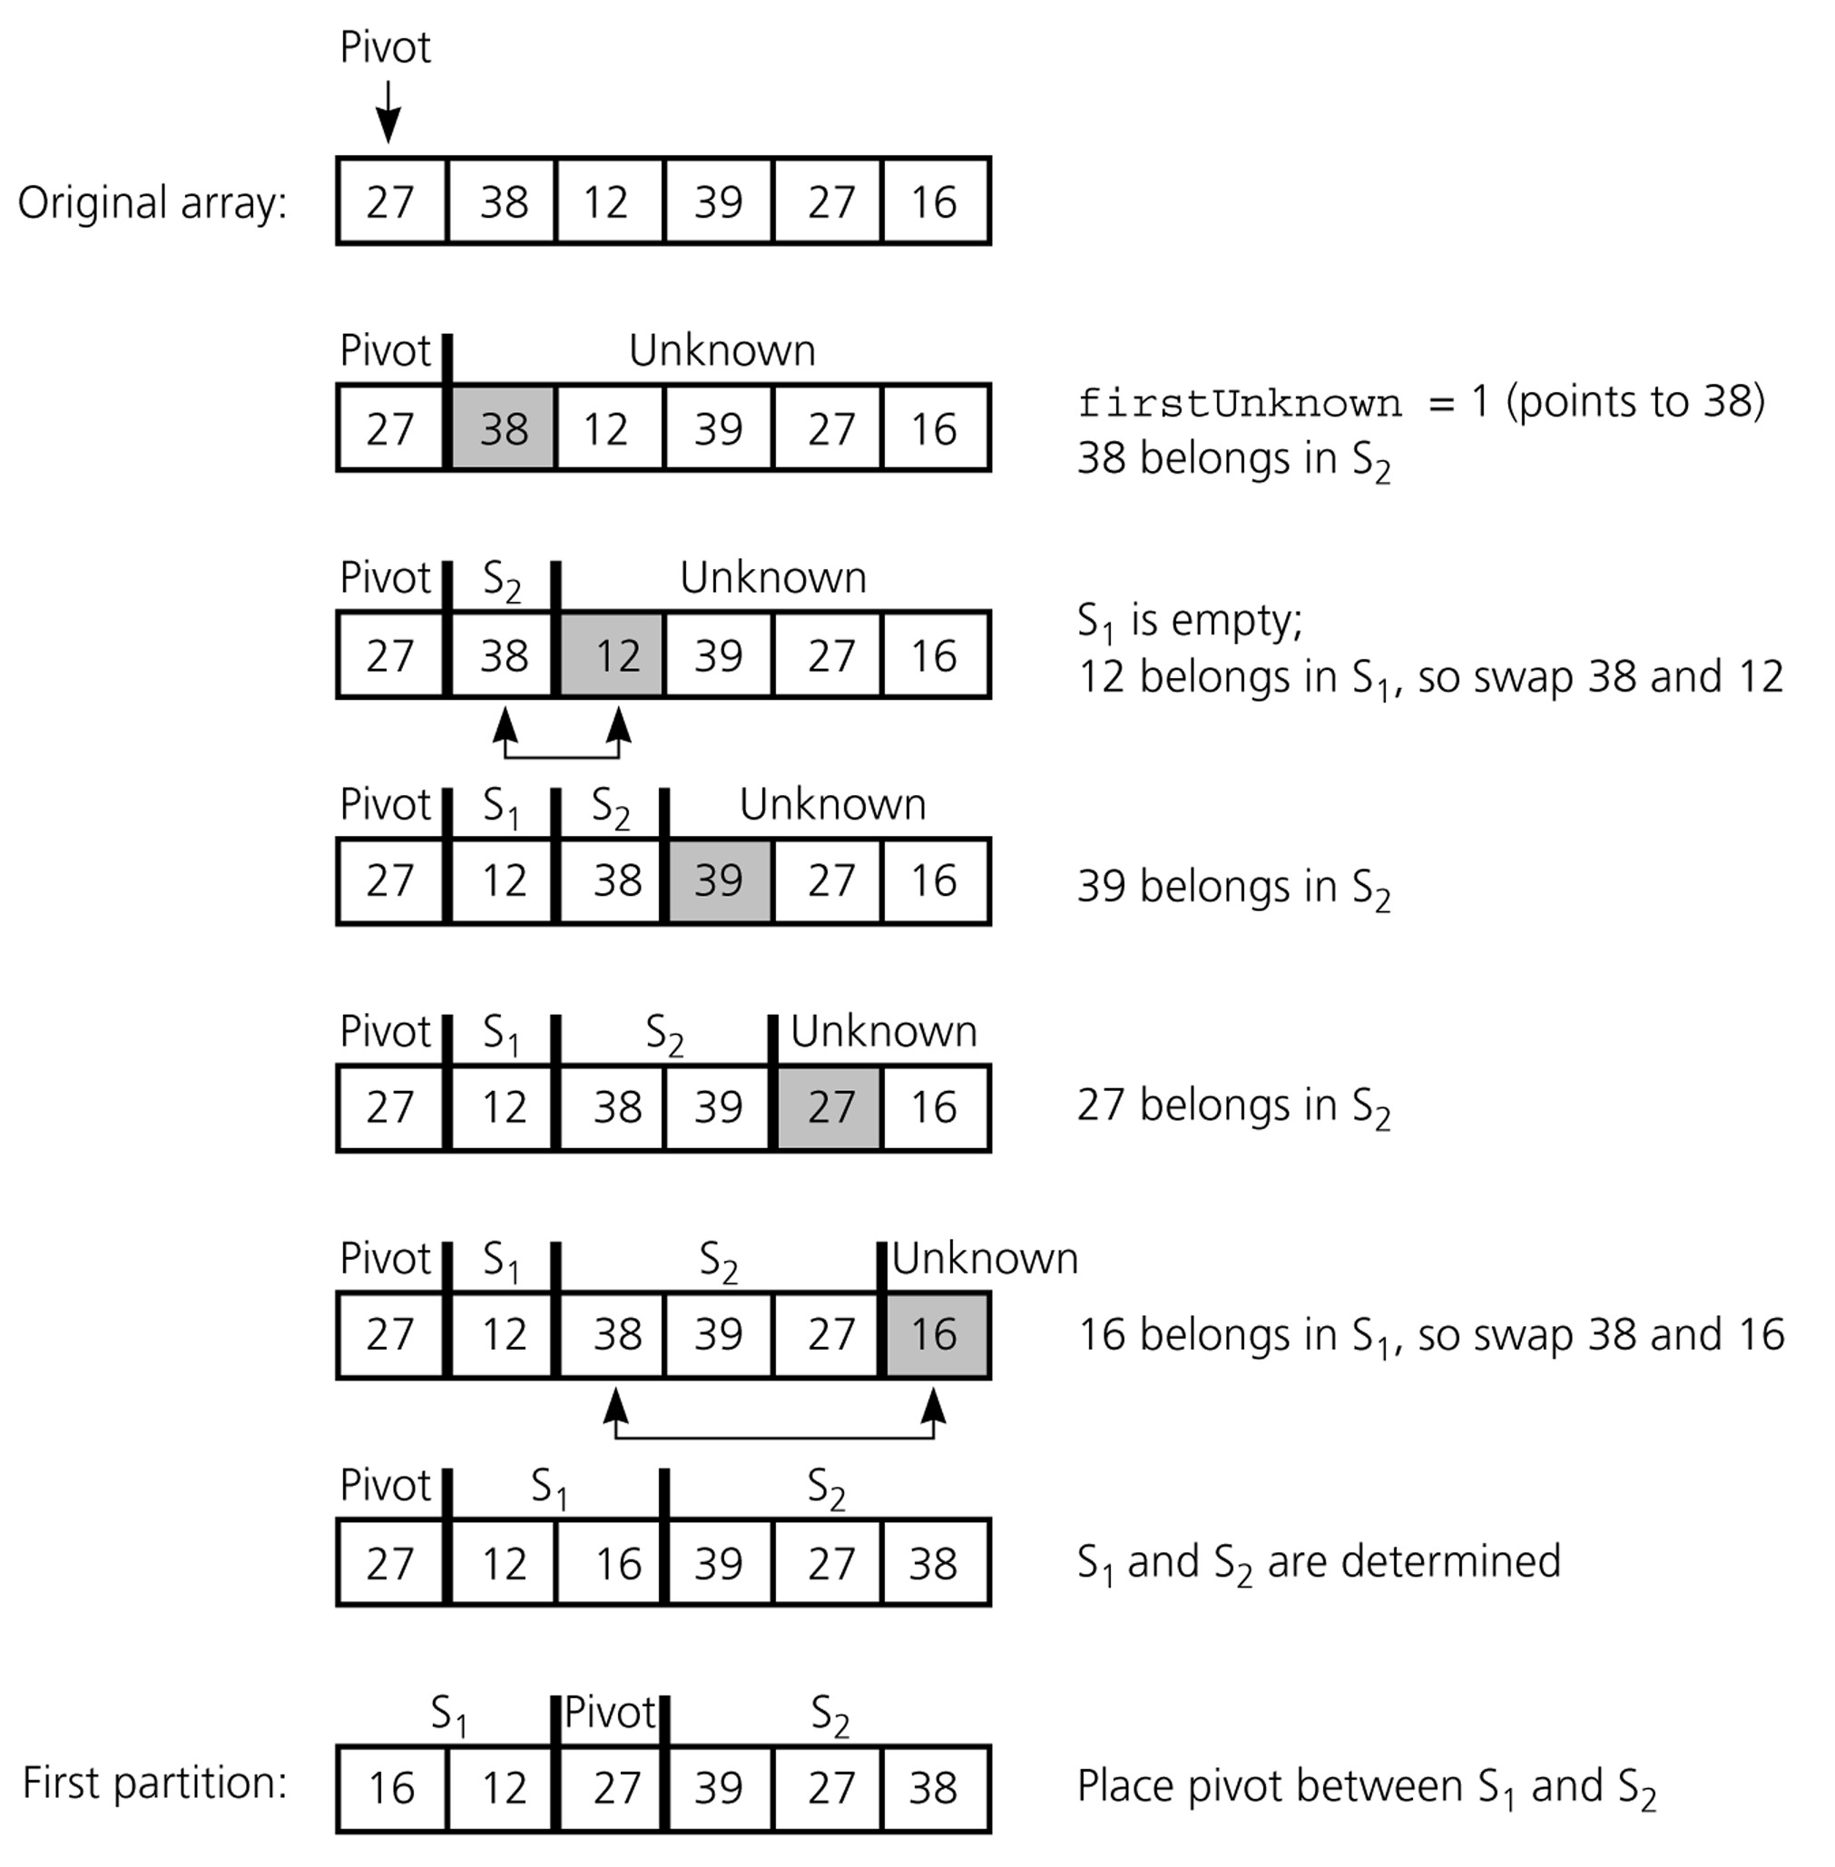
Partition Function (cont.)
Developing the first
partition of an array
when the pivot is the
first item

Slide 43
Quicksort Function
void quicksort(DataType theArray[], int first, int last) {
// Sorts the items in an array into ascending order.
// Precondition: theArray[first..last] is an array.
// Postcondition: theArray[first..last] is sorted.
// Calls: partition.
int pivotIndex;
if (first < last) {
// create the partition: S1, pivot, S2
partition(theArray, first, last, pivotIndex);
// sort regions S1 and S2
quicksort(theArray, first, pivotIndex-1);
quicksort(theArray, pivotIndex+1, last);
}
}

Slide 44
Quicksort – Analysis
Worst Case: (assume that we are selecting the first element as pivot)
  The pivot divides the list of size n into two sublists of sizes 0 and n-1.
  The number of key comparisons
  = n-1 + n-2 + ... + 1
  = n²/2 – n/2 ➔ O(n²)
  The number of swaps =
  = n-1 + n-1 + n-2 + ... + 1
  swaps outside of the for loop swaps inside of the for loop
  = n²/2 + n/2 - 1 ➔ O(n²)
So, Quicksort is O(n²) in worst case

Slide 45
Quicksort – Analysis
Quicksort is O(n*log₂n) in the best case and average case.
Quicksort is slow when the array is sorted and we choose the first element as the pivot.
Although the worst case behavior is not so good, its average case behavior is much better than its worst case.
  So, Quicksort is one of best sorting algorithms using key comparisons.

Slide 46
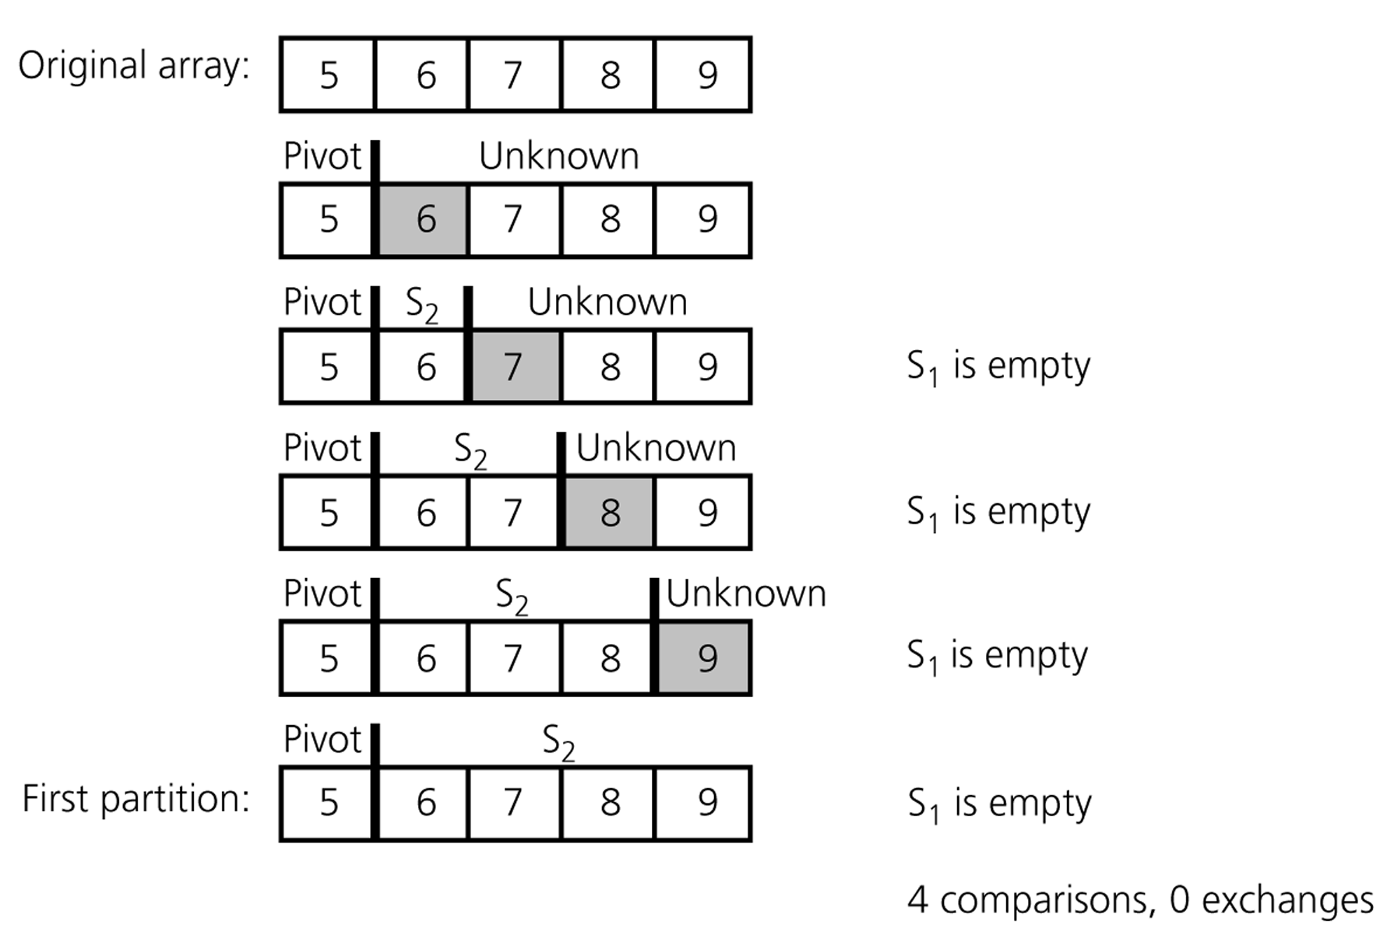
Quicksort – Analysis
A worst-case partitioning with quicksort

Slide 47
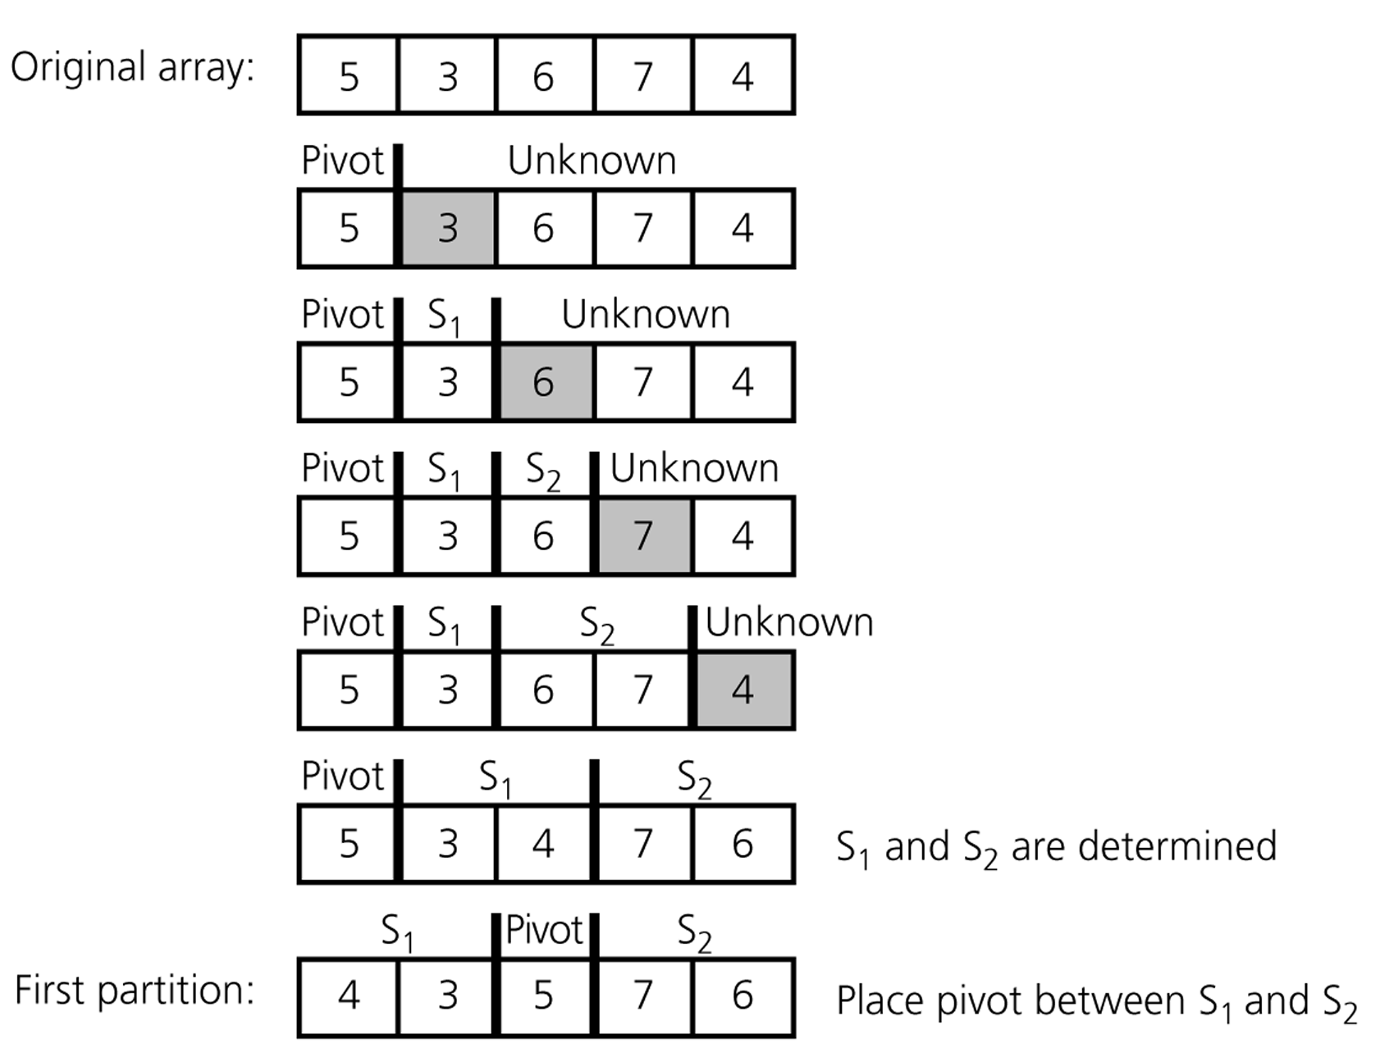
Quicksort – Analysis
An average-case partitioning with quicksort

Slide 48
Radix Sort
Radix sort algorithm different than other sorting algorithms that we talked.
  It does not use key comparisons to sort an array.
The radix sort :
  Treats each data item as a character string.
  First it groups data items according to their rightmost character, and put these groups into order w.r.t. this rightmost character.
  Then, combine these groups.
  We, repeat these grouping and combining operations for all other character positions in the data items from the rightmost to the leftmost character position.
  At the end, the sort operation will be completed.

Slide 49
Radix Sort – Example
mom, dad, god, fat, bad, cat, mad, pat, bar, him original list
(dad,god,bad,mad) (mom,him) (bar) (fat,cat,pat) group strings by rightmost letter
dad,god,bad,mad,mom,him,bar,fat,cat,pat combine groups
(dad,bad,mad,bar,fat,cat,pat) (him) (god,mom) group strings by middle letter
dad,bad,mad,bar,fat,cat,pat,him,god,mom combine groups
(bad,bar) (cat) (dad) (fat) (god) (him) (mad,mom) (pat) group strings by first letter
bad,bar,cat,dad,fat,god,him,mad,mom,par combine groups (SORTED)

Slide 50
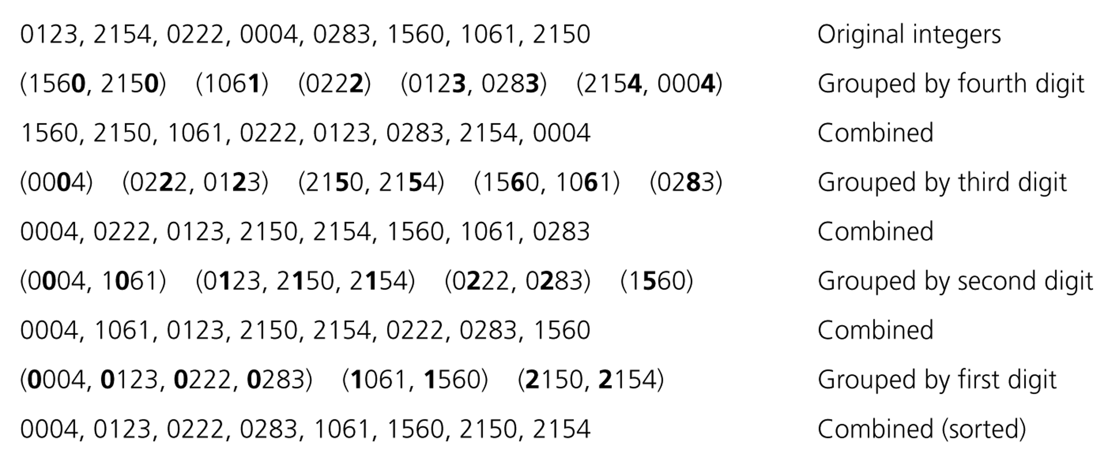
Radix Sort – Example

Slide 51
Radix Sort - Algorithm
radixSort(inout theArray:ItemArray, in n:integer, in d:integer)
// sort n d-digit integers in the array theArray
for (j=d down to 1) {
Initialize 10 groups to empty
Initialize a counter for each group to 0
for (i=0 through n-1) {
k = jth digit of theArray[i]
Place theArrar[i] at the end of group k
Increase kth counter by 1
}
Replace the items in theArray with all the items in group 0,
followed by all the items in group 1, and so on.
}

Slide 52
Radix Sort -- Analysis
The radix sort algorithm requires 2*n*d moves to sort n strings of d characters each.
➔ So, Radix Sort is O(n)
Although the radix sort is O(n), it is not appropriate as a general-purpose sorting algorithm.
  Its memory requirement is d * original size of data (because each group should be big enough to hold the original data collection.)
  For example, we need 27 groups to sort string of uppercase letters.
  The radix sort is more appropriate for a linked list than an array. (we will not need the huge memory in this case)

Slide 53
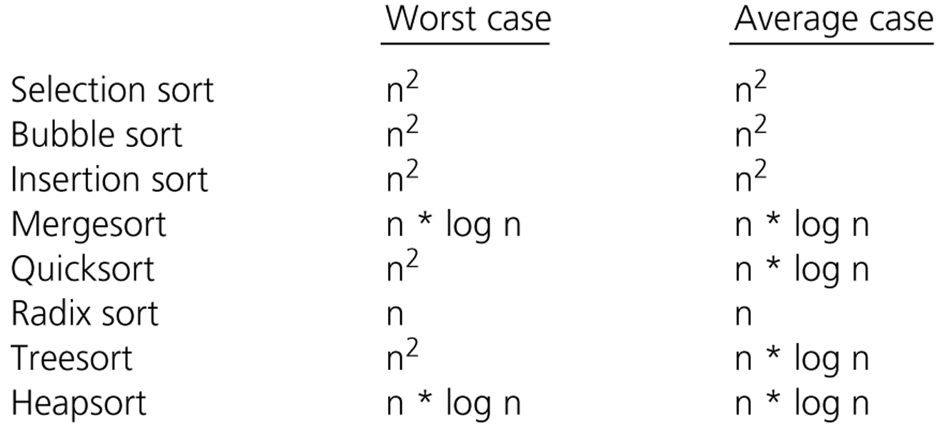
Comparison of Sorting Algorithms

